Slide 1
CS 6041 Theory of Computation Overview
Kun Suo
Computer Science, Kennesaw State University
https://kevinsuo.github.io/

Slide 2
Self Introduction
Kun Suo, Ph.D.
Homepage, https://kevinsuo.github.io/
Research interests:
Cloud computing and virtualization;
Operating systems, containers and kubernetes;
Software defined network (SDN) and network function virtualization (NFV)
Big data systems and machine learning systems
Projects you may be interested in:
Several projects in Cloud & Data & Edge
https://kevinsuo.github.io/code-lab.html

Slide 3
Now it’s your turn
Name, program/year, where from
Your interests in Computer Science
What do you expect in the Theory of Computation?
https://www2.eecs.berkeley.edu/Research/Areas/CS/
If you are in the online course, introduce yourself in D2L, Discussions → Self-Introduction

Slide 4
What does Theory of Computation include?
A study of topics from theoretical computer science that includes
Automata and languages
Computability theory
Complexity theory
How efficiently (how fast, how much space, etc.) problems can be solved on a model of computation, using an algorithm

Slide 5
What does Theory of Computation include?
Example 1: L = {s | Binary strings end in 1s}.
Is it computable?
How can human beings solve it?
Can you build a machine to solve it?
0101010100011
Accept
010100010
Reject

Slide 6
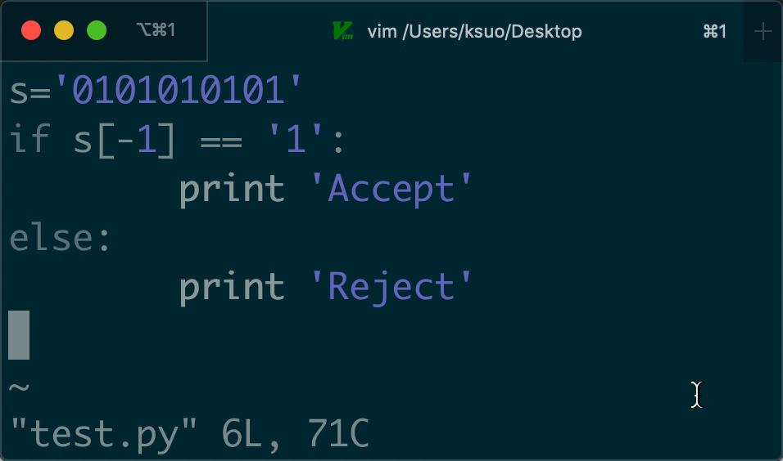
What does Theory of Computation include?

Slide 7
What does Theory of Computation include?
Example 2: Accepts all valid Java code.
Is it computable?
Can you build a machine to solve it?
How can human beings solve it?

Slide 8
What does Theory of Computation include?
Example 3 (halting problem): for input w, determine whether w will end in finite time or infinite loop.
Is it computable?
Can you build a machine to solve it?
How can human beings solve it?
There is no program that solves the halting problem.
This proof was found by Alan Turing in 1936.
https://scholar.google.com/scholar?hl=en&as_sdt=0%2C11&q=ON+COMPUTABLE+NUMBERS%2C+WITH+AN+APPLICATION+TO+THE+ENTSCHEIDUNGSPROBLEM&btnG=

Slide 9
What does Theory of Computation include?
Example 1: Binary strings end in 0s.
Example 2: Accepts all valid Java code.
Example 3 (halting problem): for input w, determine whether w will end in finite time or infinite loop.
Easy vs Hard vs Not computable
Simple machine vs Complicated machine (with knowledge)
Fast vs Slow vs Not answer (proof)
1KB vs 500MB vs …

Slide 10
Course Information
Instructor: Dr. Kun Suo
Office: J-3230
Email: ksuo@kennesaw.edu,
Only reply to e-mails that are sent from KSU student email accounts and title the course number [CS6041]
Class Hours: online D2L
Office Hours:
M/W, 4:00pm-5:00pm
By appointment
Course Materials
Homework assignments, lecture slides, and other materials will be posted in the webpage (https://kevinsuo.github.io/teaching.html) and D2L.
All lectures will be recorded.

Slide 11
Reference Book
Professor Michael Sipser (MIT)
Introduction to the Theory of Computation
3rd edition, Cengage Learning ISBN 13-978-1-133-18779-0
Buy/Rent/eBook/Library

Slide 12
Grading Policy
Grading percentage
In-class discussion and attendance: 5%
Homework (3x): 40% (please submit pdf file on D2L)
One course presentation: https://docs.google.com/spreadsheets/d/1kGszd_RWYSKGaXkznMFz3mBWH17bPJvnzU8haclL_Co/edit?usp=sharing
1st Midterm: 20%
2nd Midterm: 20%
3rd Final exam: 20%
Late submission is not accepted.

Slide 13
Course Policy
Grading scale
Percentage | Grade
90 - 100 | A
80 - 89 | B
70 - 79 | C
60 - 69 | D
Below 60 | F

Slide 14
Academic Integrity
Academic dishonesty
Cheating
Plagiarism
Collusion
The submission for credit of any work or materials that are attributable in whole or in part to another person
Taking an examination for another person
Any act designed to give unfair advantage to a student or the attempt to commit
https://scai.kennesaw.edu/KSU_Codes_of_Conduct_2019-2020.pdf
Receiving, attempting to receive, knowingly giving or attempting to give unauthorized assistance…

Slide 15
How to succeed this class
THINK hard, not WORK hard
Scientific Thinking
Passion to learn something NEW
ASK ME (office hours) / Friends / Classmates questions
Begin homework assignments EARLY

Slide 16
Where to go for help ?
Ask questions in class
Ask questions outside class
Classmates and friends
Attend office hours
Dr. Kun Suo: M/W 4:00PM – 5:00PM, J-3230 or make an appointment
Search on the web
Stand on the shoulder of giants

Slide 17
Course Content Overview
0. Introduction
1. Regular language
2. Context-free language
3. Turing machine
4. Decidability
5. Reducibility
6. Advanced Topics in Computability Theory
7. Time complexity
8. Space complexity
9. Intractability
10. Advanced topics in complexity theory

Slide 18
Course Content Overview
Chapter 0 Introduction
Chapter 1 Regular Languages
Chapter 2 Context-Free Languages
Chapter 3 The Church-Turing Thesis
Chapter 4 Decidability
Chapter 5 Reducibility
Chapter 7 Time Complexity

Slide 19
Course Content Overview
Chapter 0 Introduction
Chapter 1 Regular Languages
Chapter 2 Context-Free Languages
Chapter 3 The Church-Turing Thesis
Chapter 4 Decidability
Chapter 5 Reducibility
Chapter 7 Time Complexity
Exam 1
Exam 2
Exam 3

Slide 20
Course Content Overview
Week/Date | Topic | Chapters | Assignment
1 | Introduction and overview | 0 | HW1
2 | Deterministic finite automata | 1.1
3 | Nondeterministic finite automata | 1.2 | HW2
4 | Regular expression and Regular language | 1.3
5 | Non-regular language | 1.4 | HW3
6 | Exam 1
7 | Context free language | 2.1 | HW4
8 | Pushdown Automata | 2.2
9 | Non-Context free language | 2.3
10 | Exam 2
11 | Turing machine | 3 | HW5
12 | Decidability | 4
13 | Reducibility | 5 | HW 6
14 | Complexity and NP-completeness | 7
15 | Conclusion
16 | Exam 3

Slide 21
Course Content Overview
Week/Date | Topic | Chapters | Assignment
1 | Introduction and overview | 0
2 | Deterministic finite automata | 1.1
2 | Nondeterministic finite automata | 1.2 | HW1
3 | Regular expression and Regular language | 1.3
3 | Non-regular language | 1.4
4 | Exam 1
4 | Context free language | 2.1 | HW2
5 | Pushdown Automata | 2.2
5 | Non-Context free language | 2.3
6 | Exam 2
6 | Turing machine | 3
7 | Decidability | 4
7 | Reducibility | 5 | HW 3
8 | Complexity and NP-completeness | 7
8 | Conclusion
9 | Exam 3

Slide 22
Language is the foundation of computation
Java source code
Read by people
Binary code
Read by machines

Slide 23
Language is the foundation of computation
A word document is a language

Slide 24
Language is the foundation of computation
A figure is a language

Slide 25
Language universe in a big picture
Are the languages all the same?

Slide 26
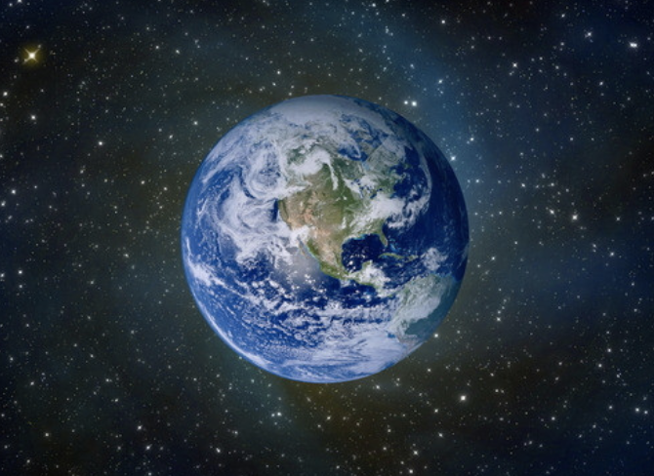
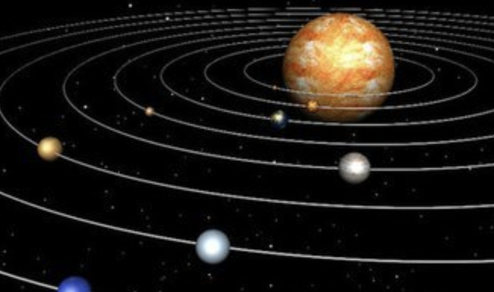
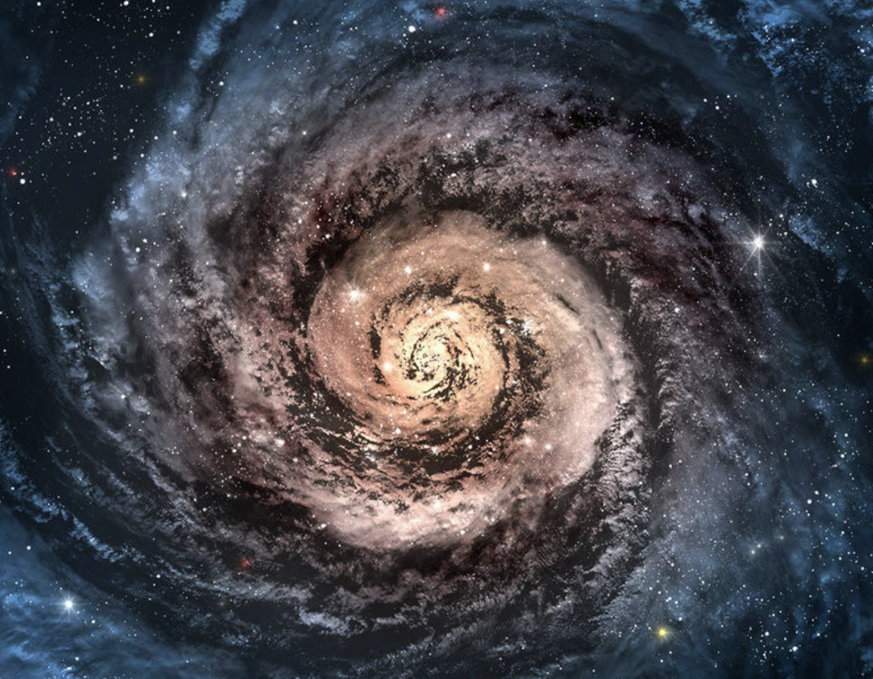
Language universe in a big picture
Are the languages all the same?
Satellite << Planet << Star << …
Earth
Solar system
Galaxy

Slide 27
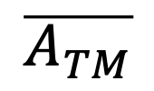
Language universe in a big picture
$$\overline{A_{TM}}$$
Turing-recognizable
decidable
Regular
context
free

Slide 28
Language universe in a big picture
Regular language <==>
DFA: deterministic finite automata
NFA: non-deterministic finite automata
RE: regular expression
$$\overline{A_{TM}}$$
Turing-recognizable
decidable
Regular
context
free

Slide 29
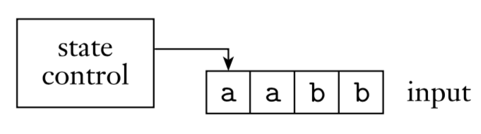
Language universe in a big picture
Close
finite automaton
Front
Back
DFA example:
Automatic Door

Slide 30
Language universe in a big picture
Regular language <==>
DFA: deterministic finite automata
NFA: non-deterministic finite automata
RE: regular expression
$$\overline{A_{TM}}$$
Turing-recognizable
decidable
Regular
context
free
CFL: context free language
CFG: context free grammar
PDA: push down automata

Slide 31
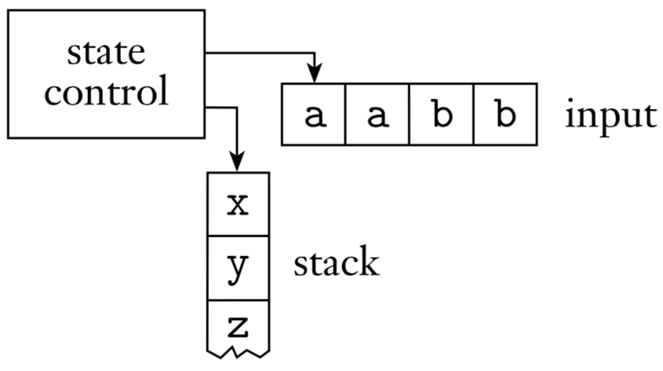
Language universe in a big picture
finite automaton
pushdown automaton
R
R
memory size = 1
Not only current input
But also previous inputs

Slide 32
Language universe in a big picture
Regular language <==>
DFA: deterministic finite automata
NFA: non-deterministic finite automata
RE: regular expression
$$\overline{A_{TM}}$$
Turing-recognizable
decidable
Regular
context
free
CFL: context free language
CFG: context free grammar
PDA: push down automata
TM: turing machine

Slide 33
Language universe in a big picture
pushdown automaton
Turing machine
R
Input
a
a
b
b
c
R/W
Tape head
control
Turing machines are equivalent to modern electronic computers at a certain theoretical level, but differ in details.

Slide 34
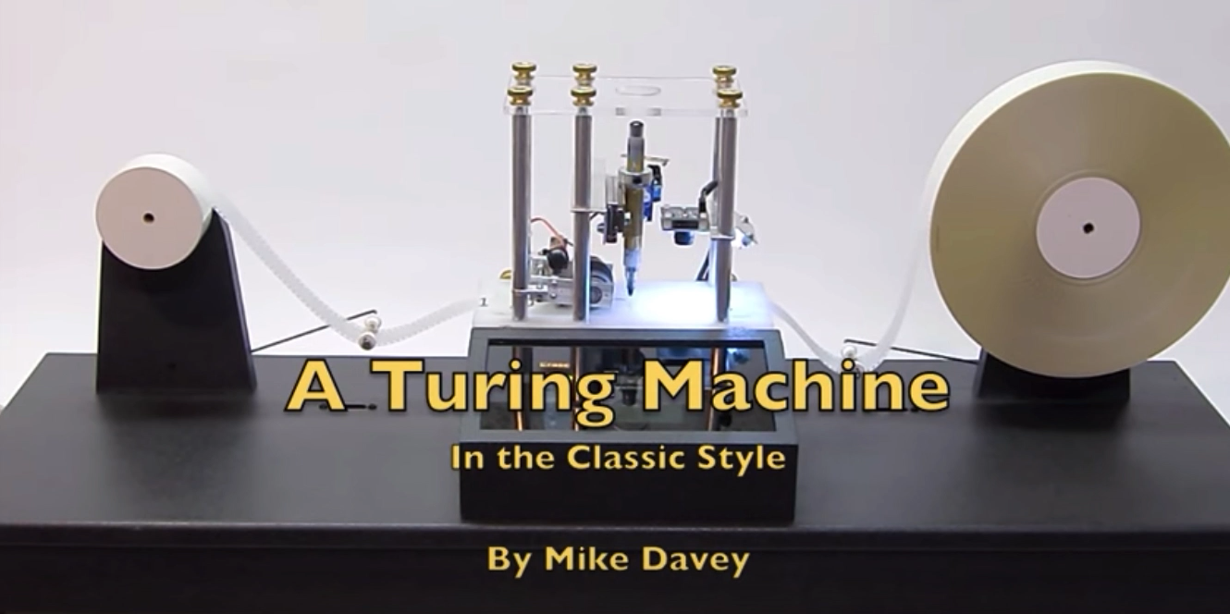
Language universe in a big picture
https://www.youtube.com/watch?v=E3keLeMwfHY

Slide 35
Language universe in a big picture
Regular language
DFA: deterministic finite automata
NFA: non-deterministic finite automata
RE: regular expression
$$\overline{A_{TM}}$$
Turing-recognizable
decidable
Regular
context
free
TM cannot solve
CFL: context free language
CFG: context free grammar
PDA: push down automata
TM: turing machine

Slide 36
Language universe in a big picture
P problem:
The general class of questions for which some algorithm can provide an answer in polynomial time
Give the answer!
NP problem:
The class of questions for which an answer can be verified in polynomial time
Test the answer!

Slide 37
Language universe in a big picture
P problem:
Give the answer!
E.g., Sorting for n numbers, no longer than O(n²)
NP problem:
Test the answer!
E.g., whether a given set has a subset that the sum of all its element is 0.
s={-1,3,2,-5,6}. subset={3,2,-5}, test in O(n) time

Slide 38
Language universe in a big picture
Regular language
DFA: deterministic finite automata
NFA: non-deterministic finite automata
RE: regular expression
$$\overline{A_{TM}}$$
decidable
Turing-recognizable
context
free
P
NP
Regular
TM cannot solve
CFL: context free language
CFG: context free grammar
PDA: push down automata
TM: turing machine

Slide 39
Problems
All problems
Math problems
TM-solvable
problems
Computable
problems
Emotion
encrypt and decode
1+2+…+n
quantum
Only a small proportion of problems can be solved by Turing machines in real life

Slide 40
Conclusion
Introduction of course
Information, book, grading, …
Course content overview
Calendar, content, schedule, …
Language universe in a big picture
Regular language
CFL
Turing machine
P vs. NP

